Slide 1

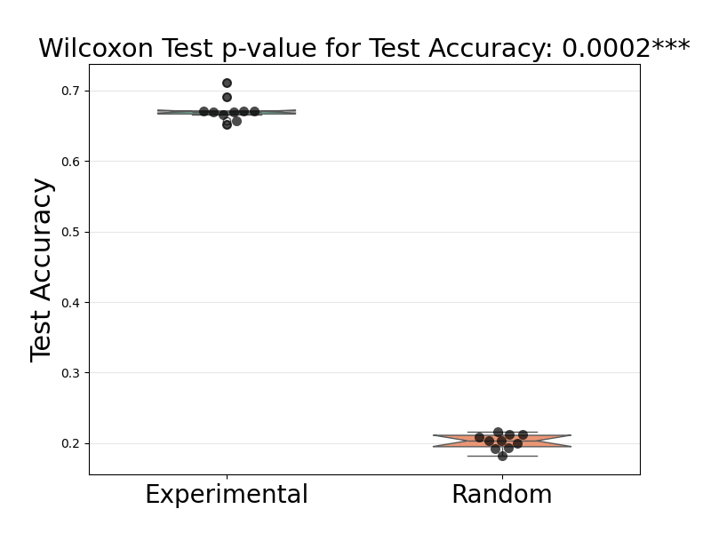
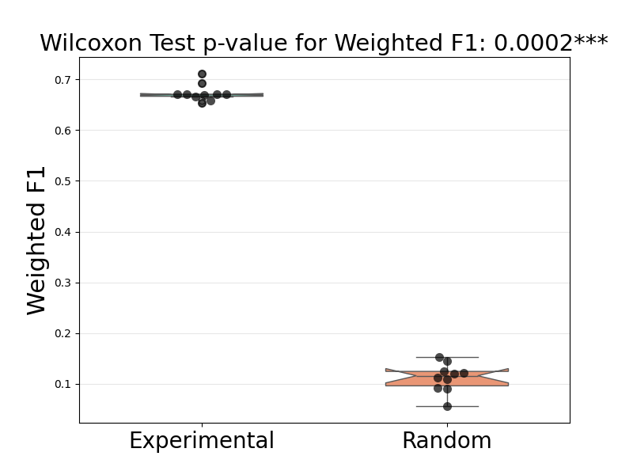
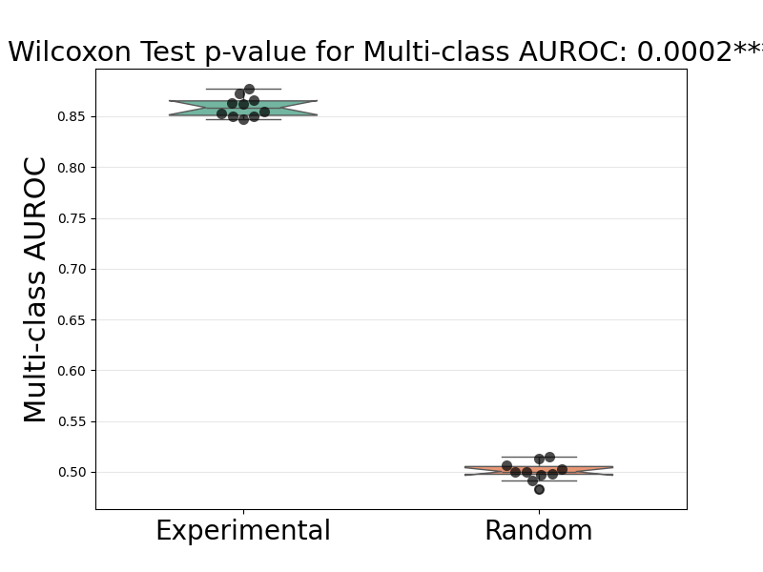
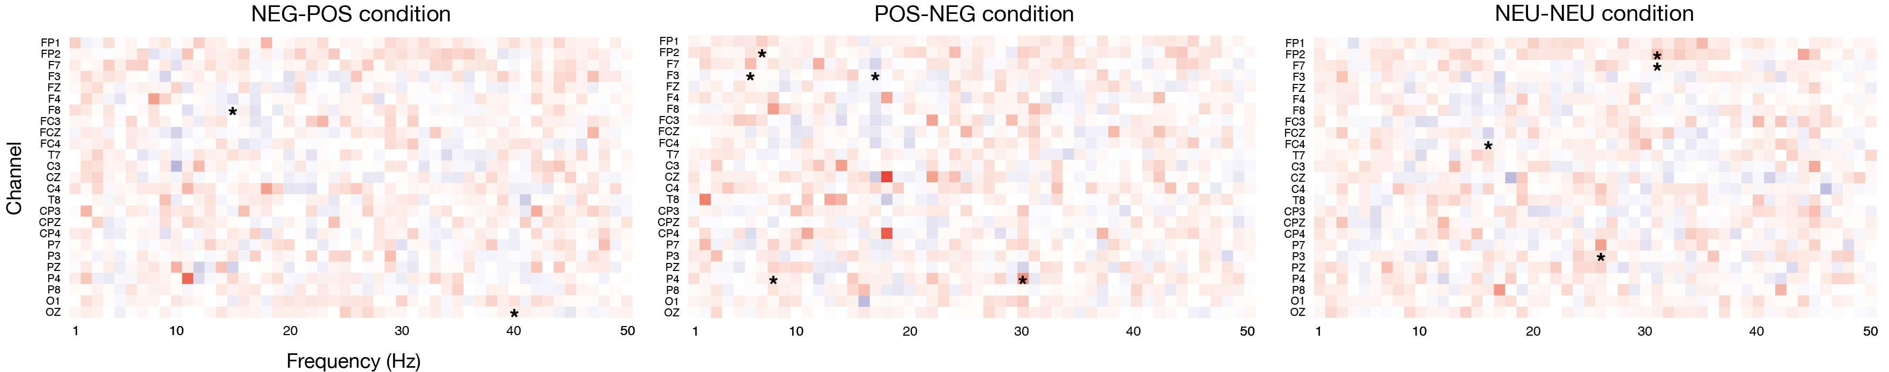
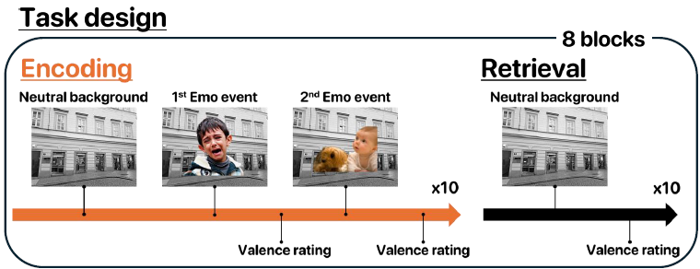
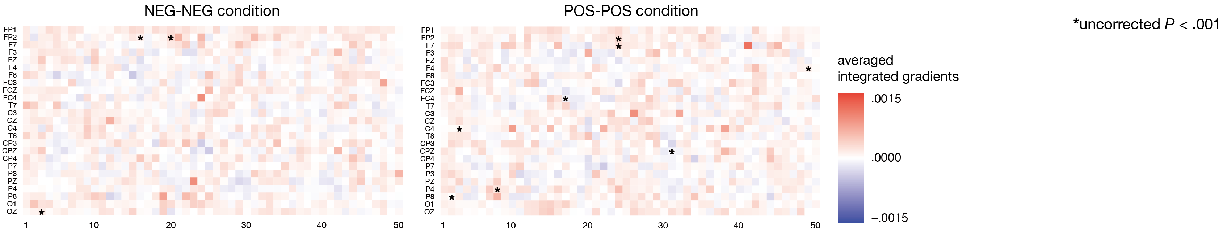
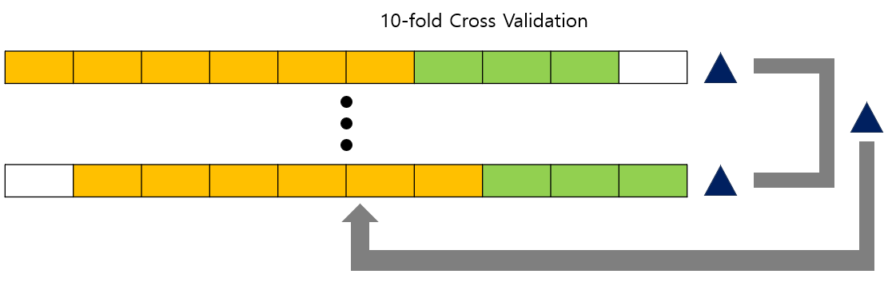
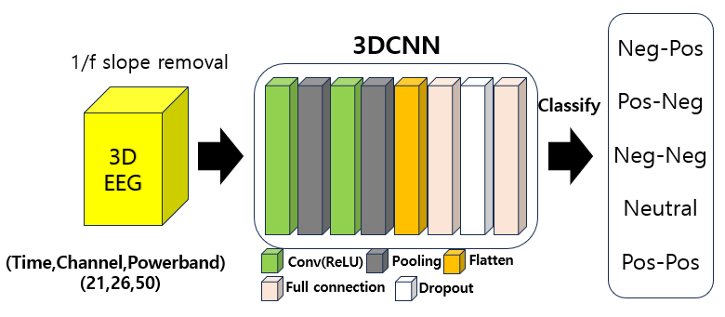

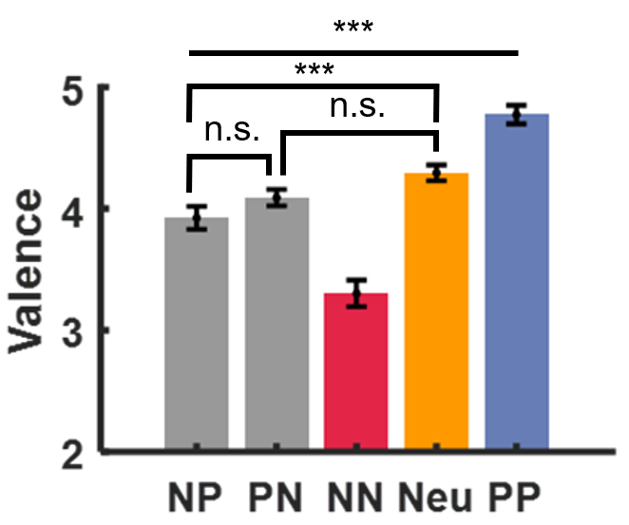
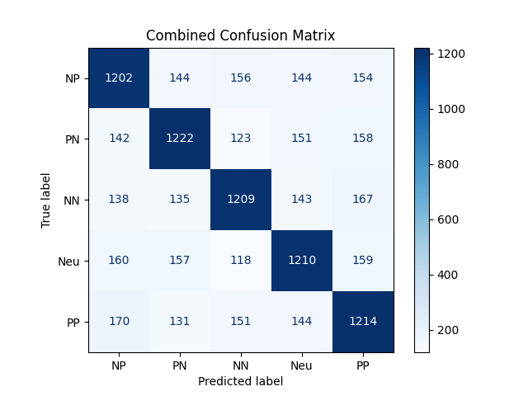

Bipolar measurement of affective valence does not differentiate neutral and ambivalent responses
Department of Psychology¹, Department of Brain Cognitive Science²
Taeyang Lee¹, Jinwoo Lee¹, Minseok Koo², Jiook Cha^{1,2}, Sangah Lee²
rlaxodid5539@snu.ac.kr
INTRODUCTION
2) Results of Model’s Test Performances
3) Results of Wilcoxon rank sum test
Model Analysis Results 1) Variance contribution Time : 0.0149, Channels : 0.0421, Powerband : 0.1634
2) Difference of Attribution Maps
There are numerous reports suggesting that ambivalent affect has distinct neural representations and physiological response profiles at the cortical level, compared to simple neutral, positive, or negative affect(Lettieri et al., 2019; .Vaccaro et al., 2024).
However, the commonly used bipolar measurement of affective valence does not allow for ambivalent responses at the self-report level.
As a result, it implicitly encourages participants to choose which valence is more dominant in ambivalent states, leading to a dichotomous evaluation that fails to clearly capture such ambivalent experiences(Schneider et al., 2016).
Therefore, we designed the stimuli that combine conflicting valence information and hypothesized that such ambivalent responses would be distinguishable from neutral and univalent responses at the neural level. However, at the self-report level, using bipolar measurements, they would not be differentiated from neutral responses.
Metric | Test Accuracy | Weighted F1 | Multi-class AUROC
Trained model | 0.6729 (SD=0.0160) | 0.6731 (SD=0.0161) | 0.8596 (SD=0.0096)
Random model | 0.2024 (SD=0.0101) | 0.1126 (SD=0.0268) | 0.5007 (SD=0.0091)
METHODS
Pick dimensions of channels and powerband to make 2D map
Data Collection Participants : 57 (31 Female), Age : 25.35 (SD = 4.23) Collect 32 Channels EEG data and Use 26 Channel’s data for analysis
Method of Analysis 1. Training an emotional stimuli classifier based on 3D CNN.
2. Model analysis through Integrated Gradients.
The channel-frequency maps representing emotional conditions differed across all emotional conditions. The neural responses for Neg-Pos, Pos-Neg, Neg-Neg, Neutral, and Pos-Pos conditions are all distinct.
DISCUSSIONS
Since brain responses related to emotions exhibit nonlinear characteristics, we opted for a nonlinear approach by training the classifier using deep learning(Lin et al., 2023; Viinikainen et al., 2010).
Ambivalent emotions exhibited a more negative valence compared to neutral emotions. In particular, the Neg-Pos condition showed lower valence than neutral, which can be explained in the context of Negativity Bias(Norris, 2021; Waugh et al., 2019).
EEG patterns differed distinctly across the emotional conditions. 1) The partial activation of frontal beta waves observed in the Neg-Neg condition especially in right hemisphere is associated with negative emotions(Güntekin, B., & Başar, E., 2010). 2) The high beta wave patterns observed in the Pos-Pos condition are associated with positive emotions(Mishra et al., 2022). 3) The part of frontal theta waves observed in the Pos-Neg condition is associated with emotional regulation, suggesting a connection to ambivalent emotion(Park et al., 2011).
This study highlights the limitation of using a simple 1D valence measure in accurately linking the neural differences observed between neutral and ambivalent emotions to behavioral outcomes.
Future research could explore whether nonbipolar measurements, such as a 2D valence scale, can better capture these subtle differences.
By this process, we can identify which features are important for emotion classification.
(Smilkov et al., 2017)
RESULTS
Behavioral Results
Model Training Results 1) Confusion matrix
Neg-Pos & Pos-Neg Mean difference = -0.159, t = -1.870 (p<.628)
Pos-Neg & Neutral Mean difference = -0.197, t = -2.305 (p<.221)
Neg-Pos & Neutral Mean difference = -0.356, t = -4.175 (p<.001)
The overall pattern was 'NN < NP < PN < Neutral < PP,' with no significant differences observed between Neg-Pos and Pos-Neg, and between Pos-Neg and Neutral.
REFERENCES
The model demonstrated balanced performance across all emotional conditions.
Lettieri, G., Handjaras, G., Ricciardi, E., Leo, A., Papale, P., Betta, M., … & Cecchetti, L. (2019). Emotionotopy in the human right temporo-parietal cortex. Nature communications, 10(1), 5568.
Vaccaro, A. G., Wu, H., Iyer, R., Shakthivel, S., Christie, N. C., Damasio, A., & Kaplan, J. (2024). Neural patterns associated with mixed valence feelings differ in consistency and predictability throughout the brain. Cerebral Cortex, 34(4), bhae122.
Schneider, I. K., Veenstra, L., van Harreveld, F., Schwarz, N., & Koole, S. L. (2016). Let’s not be indifferent about neutrality: Neutral ratings in the International Affective Picture System (IAPS) mask mixed affective responses. Emotion, 16(4), 426.
Lin, C., Bulls, L. S., Tepfer, L. J., Vyas, A. D., & Thornton, M. A. (2023). Advancing naturalistic affective science with deep learning. Affective Science, 4(3), 550-562.
Viinikainen, M., Jääskeläinen, I. P., Alexandrov, Y., Balk, M. H., Autti, T., & Sams, M. (2010). Nonlinear relationship between emotional valence and brain activity: evidence of separate negative and positive valence dimensions. Human brain mapping, 31(7), 1030-1040.
Smilkov, D., Thorat, N., Kim, B., Viégas, F., & Wattenberg, M. (2017). Smoothgrad: removing noise by adding noise. arXiv preprint arXiv:1706.03825.
Norris, C. J. (2021). The negativity bias, revisited: Evidence from neuroscience measures and an individual differences approach. Social neuroscience, 16(1), 68-82.
Waugh, C. E., Running, K. E., Reynolds, O. C., & Gotlib, I. H. (2019). People are better at maintaining positive than negative emotional states. Emotion, 19(1), 132.
Güntekin, B., & Başar, E. (2010). Event-related beta oscillations are affected by emotional eliciting stimuli. Neuroscience letters, 483(3), 173-178.
Mishra, S., Srinivasan, N., & Tiwary, U. S. (2022). Dynamic functional connectivity of emotion processing in beta band with naturalistic emotion stimuli. Brain sciences, 12(8), 1106.
Park, K. S., Choi, H., Lee, K. J., Lee, J. Y., An, K. O., & Kim, E. J. (2011). Emotion recognition based on the asymmetric left and right activation. International Journal of Medicine and Medical Sciences, 3(6), 201-209.

